Slide 1
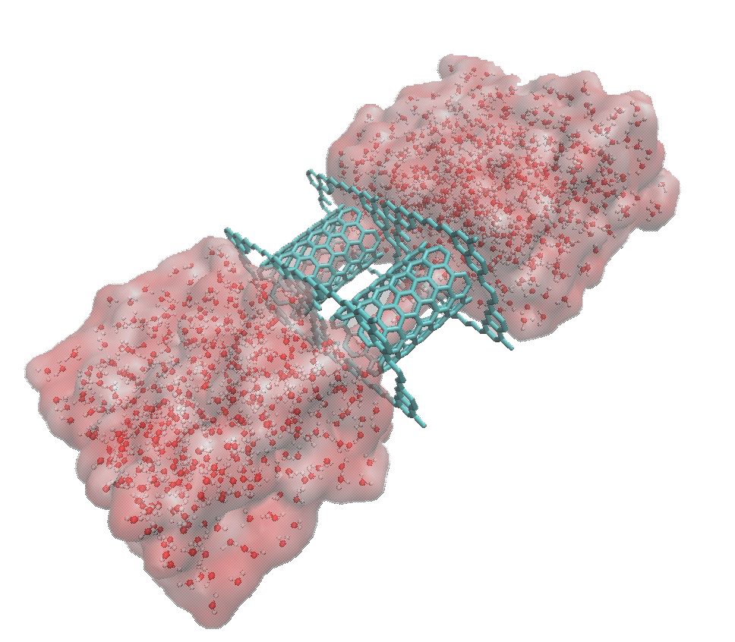
STUDY OF WATER TRANSPORT UNDER NON-EQUILIBRIUM CONDITIONS THROUGH CNTS
Daniel Bedmar
Notes:
Good morning, I'm Daniel Bedmar, and I have the privilege of opening this final round of presentations by introducing my work on water transport through carbon nanotubes using molecular dynamics.

Slide 2

JUSTIFICATION
Notes:
Before I explain the process I have followed or share my results with you, I believe it's appropriate to explain the justification for this work.

Slide 3
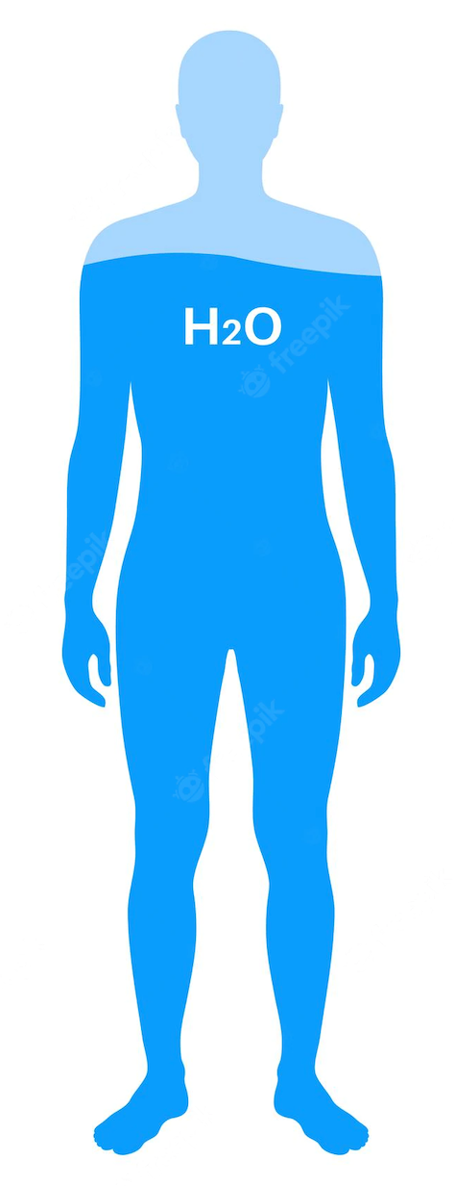
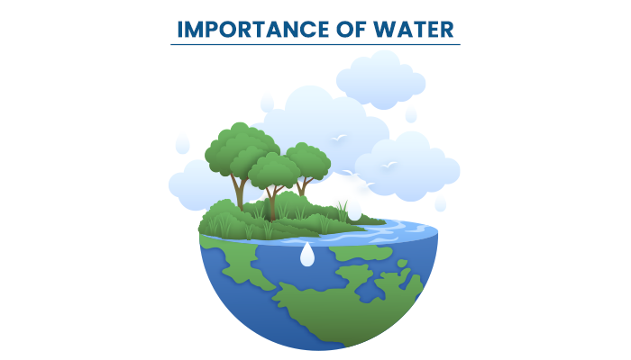
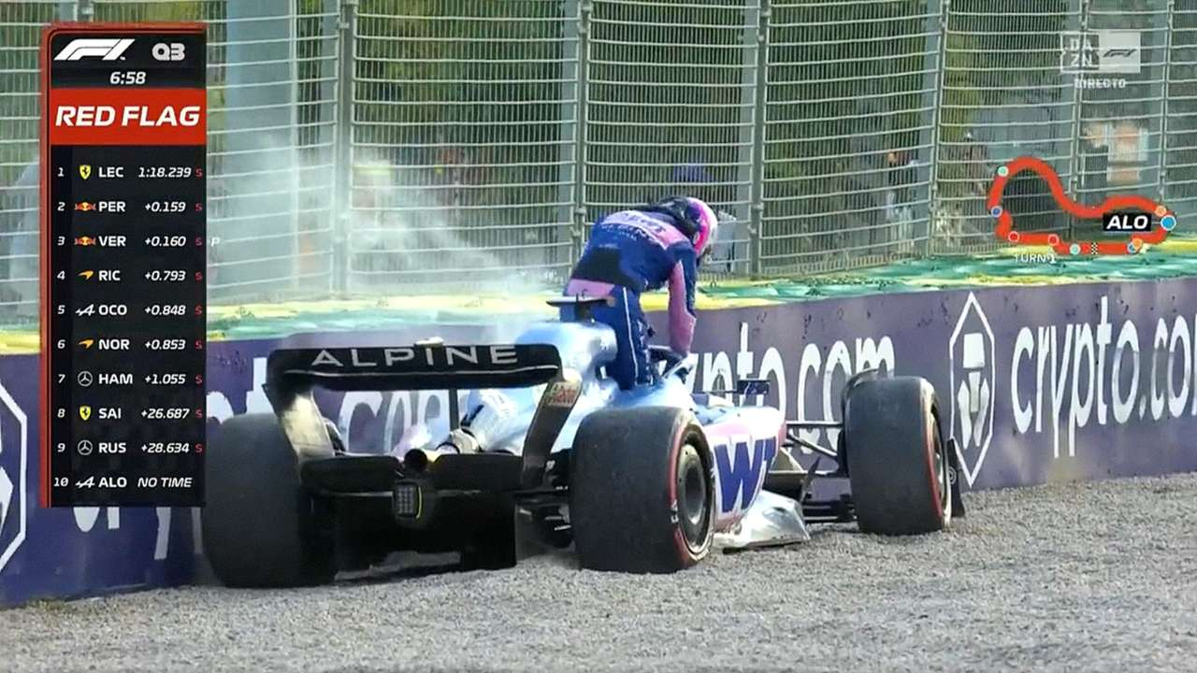
JUSTIFICATION
Notes:
First of all, this work explores water transport through carbon nanotubes. Why water? Well, because...
Water is a compound to which we have direct access and which is abundantly available in our environment (although decreasingly so). This has made it one of the most familiar liquids, both to us and to all living organisms. It is the universal solvent par excellence, present in practically all biochemical processes, and is fundamental to nearly every aspect imaginable in our current society. Therefore, seeking to understand its transport at any scale is an attractive area of study.

Slide 4
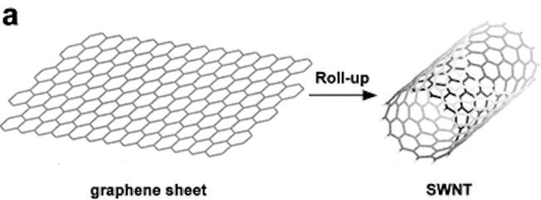
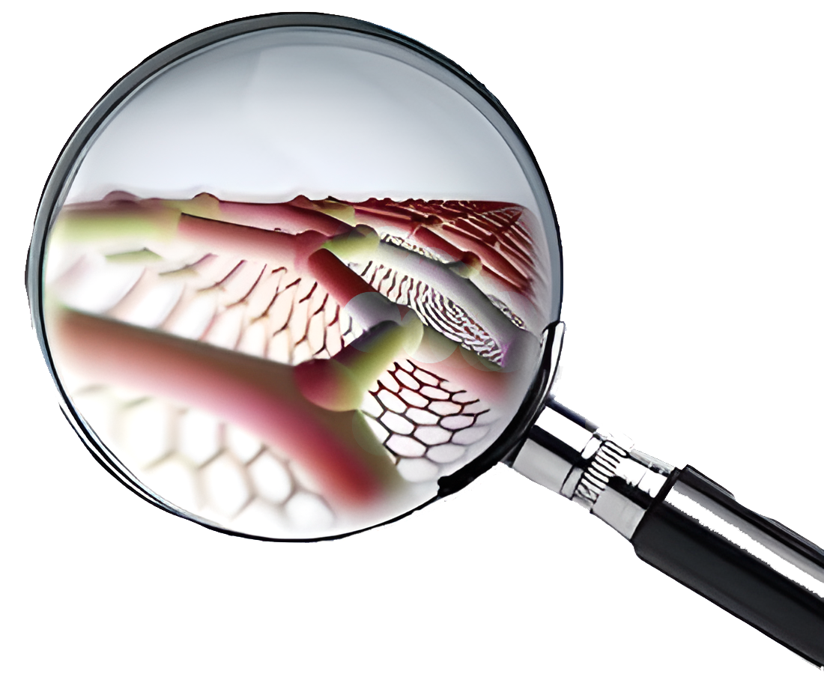

JUSTIFICATION
Notes:
And as we all know, in recent decades, science has been making strides in studying matter at smaller scales, with nanoscience being one of the most intriguing disciplines. It allows us to explore molecules with surprising properties, one of which is carbon nanotubes. Carbon nanotubes exhibit a wide range of remarkable properties due to their unique structure and composition. Among these properties are their smooth molecular-scale surfaces, high hydrophobicity, and immense aspect ratio, making carbon nanotubes incredibly efficient channels for water transport.

Slide 5


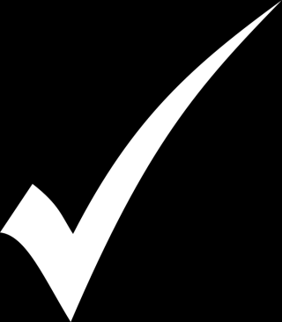
STUDY OF THE PHENOMENA
REASONABLE SIMPLIFICATIONS
JUSTIFICATION
MANY ATOMS SYSTEMS
COST COMPUTACIONAL REASONABLE
Notes:
L’estudi d’aquest fenòmen, com ja he dit s’ha fet a travès de dinàmica molecular amb el porgrama NAMD.
Vaig decidir utilitzar dinàmica molecular perquè aquesta fa unes simplificacions raonables que em permeten estudiar el fenòmen del transport però a l’hora em permet estudiar sistemes prous grans mantenint un cost de computació raonable.

Slide 6

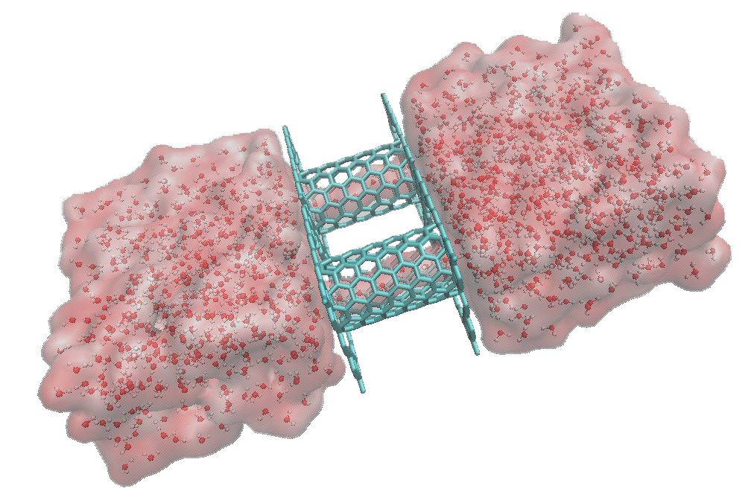
METHODS
.pdb
.psf
.inp
.namd
Notes:
"To perform simulations with NAMD, as you already know, various input files are required to carry out the simulations."

Slide 7
.pdb
.psf
METHODS
Coordinates
Atom names
and segments
Beta factor and occupancy
Mass and
electric charge
Bonds, angles and dihedrals
Notes:
The first input files I created were the .pdb and .psf files.
As you know, the .pdb file provides properties such as atom coordinates, names, and IDs of atoms and segments of the molecule, along with additional values such as the beta factor and atom occupancy. The .psf file defines other parameters, such as the mass and charge of atoms, as well as the bonds formed, including their angles and dihedrals.

Slide 8
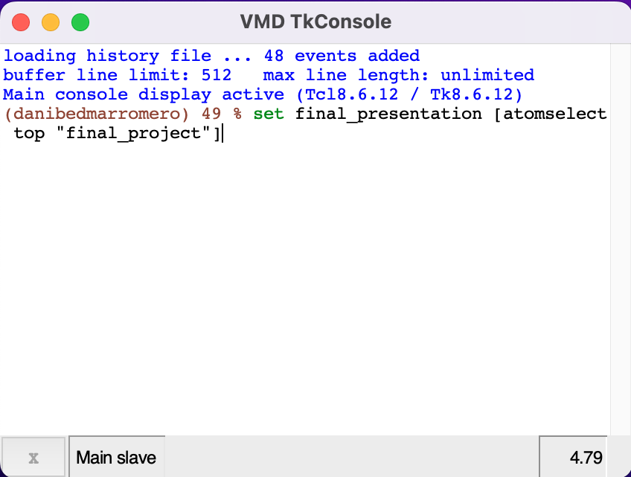
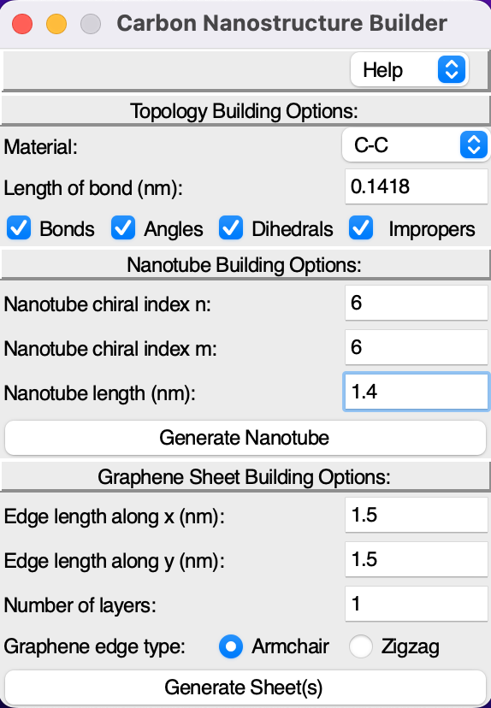
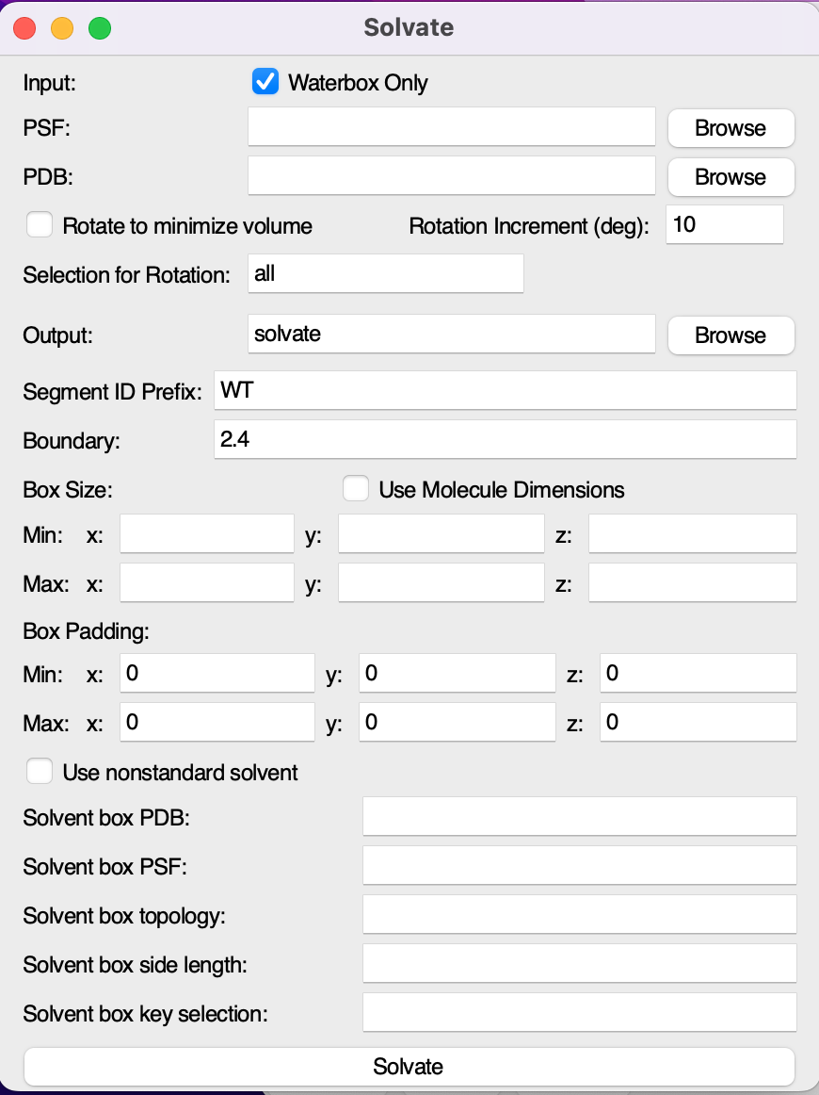
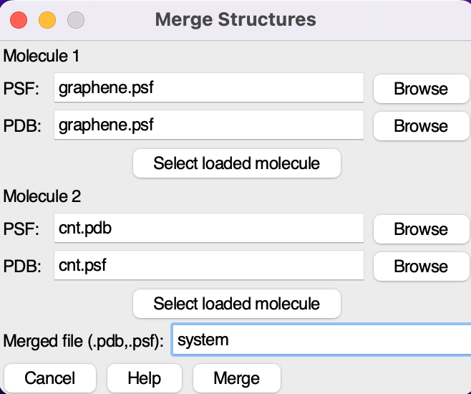
METHODS
Notes:
My system consisted of an extension of the system that Jordi taught us in class, where we had a carbon nanotube with two water reservoirs at each end and graphene sheets with a hole to isolate the space between the reservoirs. As you know, the procedure for creating these structures involves a combination of using plugins to generate nanotubes, graphene sheets, merging different structures, the plugin for solvating volumes, and utilizing the TkConsole, all integrated into the VMD program.

Slide 9
METHODS
Notes:
The files that define the force fields consist of two: one to define the model that carbon atoms will follow, mostly from the CHARM22 force field, and another to define water, which specifies the TIP3P water model. However, both files are structured in the same way.

Slide 10
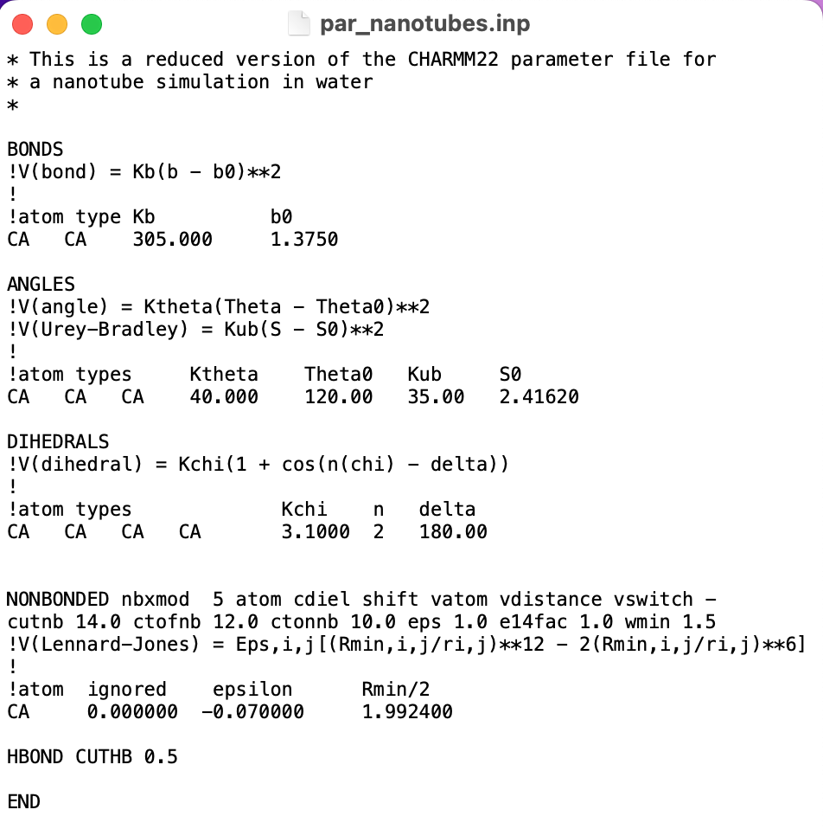
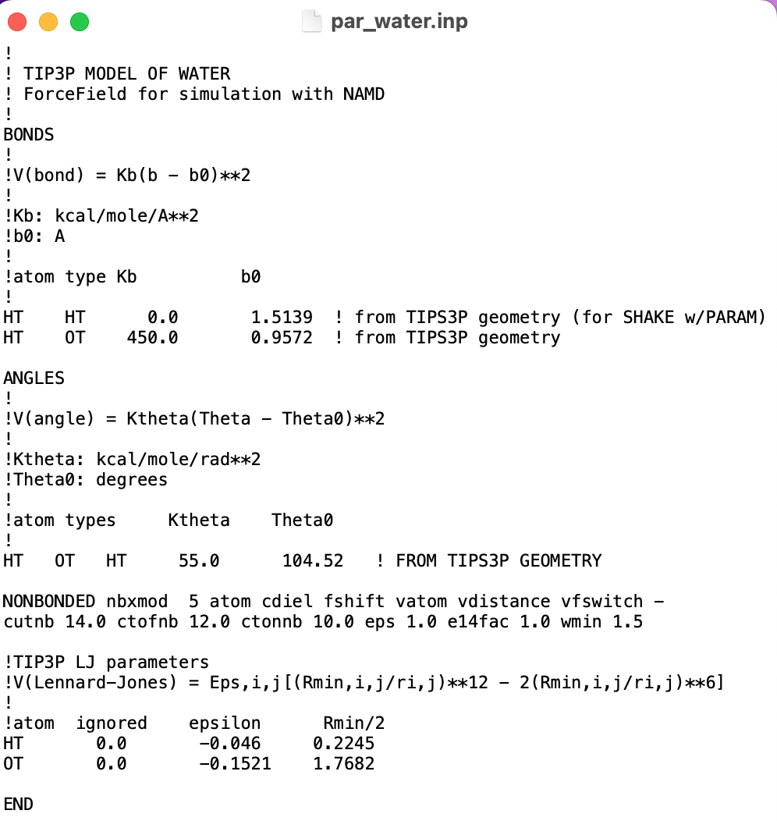
METHODS
Notes:
The files that define the force fields consist of two: one to define the model that carbon atoms will follow, mostly from the CHARM22 force field, and another to define water, which specifies the TIP3P water model. However, both files are structured in the same way.

Slide 11
METHODS
Notes:
In both cases, there is an initial section where the potential energy of chemical bonds is defined. They both follow the harmonic model, so only the force constant and equilibrium distance for each atom need to be defined. However, here we already find a difference between the two files: in the TIP3P model, the units of each parameter are defined, whereas in the excerpt from CHARM22, they are not. This trend continues throughout the rest of the file in both cases.

Slide 12
METHODS
Notes:
Afterwards, there is a section where a potential is defined to model the angles between the bonds. In this section, we find another difference: while the TIP3P model of water is a rigid model, meaning that the water molecule cannot change its bond angles, this is not the case for carbon. Therefore, in the water model, a harmonic potential is defined to specify the angles, whereas for carbon, another potential is defined to account for possible variations in the angles. This approximation of the water molecule may seem crude, but for studying the transport of many water molecules, it is quite effective and saves a significant amount of computational time.

Slide 13
METHODS
Notes:
Next, in the carbon model, a potential is defined to model the dihedrals, where we have two cosine terms. As a result, in this model, the dihedrals will have two minima. However, in water, being a three-atom molecule, there is no need to define dihedrals.

Slide 14
METHODS
Notes:
The intermolecular interactions in both cases are modeled by a Lennard-Jones 12-6 potential.

Slide 15
METHODS
Notes:
In the case of the force field for nanotubes, it is also found that the maximum distance for hydrogen bonds is 0.5 Å.

Slide 16
METHODS
Equilibration NpzT
Non equilibrium NVT
System in equilibrium
300 K
1 atm
Fixed carbon atoms
System under pressure
300 K
Fixed carbon atoms
Notes:
Finally, the last necessary input file is the one that will configure the simulation itself, dictating what exactly to simulate based on the system described above. In my case, I have carried out two types of simulations: an initial NpT equilibration and an NVT simulation in which conditions emulating pressure on the system are applied.
The objective of the first type is to observe the system under equilibrium conditions, that is, without applying any type of force or external disturbance to it. In this case, I conducted a simulation by fixing the number of particles, pressure, and temperature executed at atmospheric pressure, 300K. The simulation consists of 500 steps of minimization followed by 2500 steps of normal simulation. Each step is 2fs (0.5ns) long, and data will be collected every picosecond. It is also worth noting that the command 'set fixed_selected_atoms 1' has been used to leverage the values from the ß column and fix the carbon atoms.
The objective of the second type is to simulate the effect of applying pressure on the water in the direction in which the nanotubes are arranged, in order to verify how water transport is altered as pressure increases. To conduct this simulation, pressure is no longer fixed, but the volume is. Additionally, a Tcl script must be written in the NAMD input file to simulate this pressure.

Slide 17
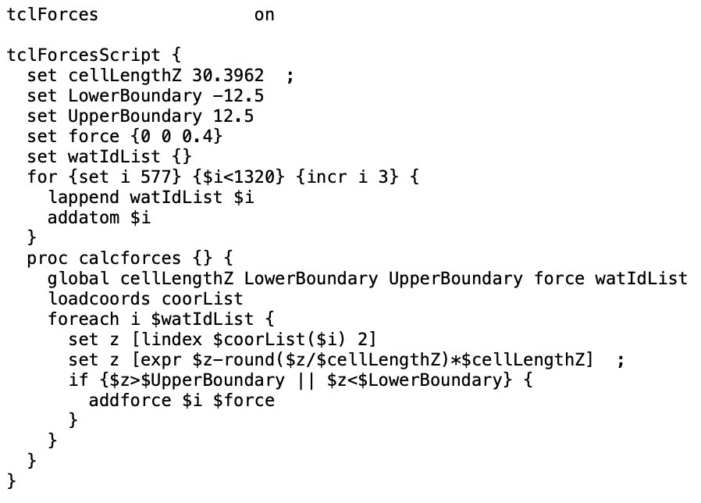
METHODS
Notes:
What this script does is, first of all, define limits in the z direction, which encompass the carbon nanotubes and a bit beyond their openings. Then, it defines a force (in units of kcal/molÅ) and adds all oxygen atoms from the system into an empty list.
Next, it iterates through this list at each simulation step and looks for the coordinates of the atoms in this list. If the z-value is outside the previously established limits, the force defined earlier is applied.

Slide 18
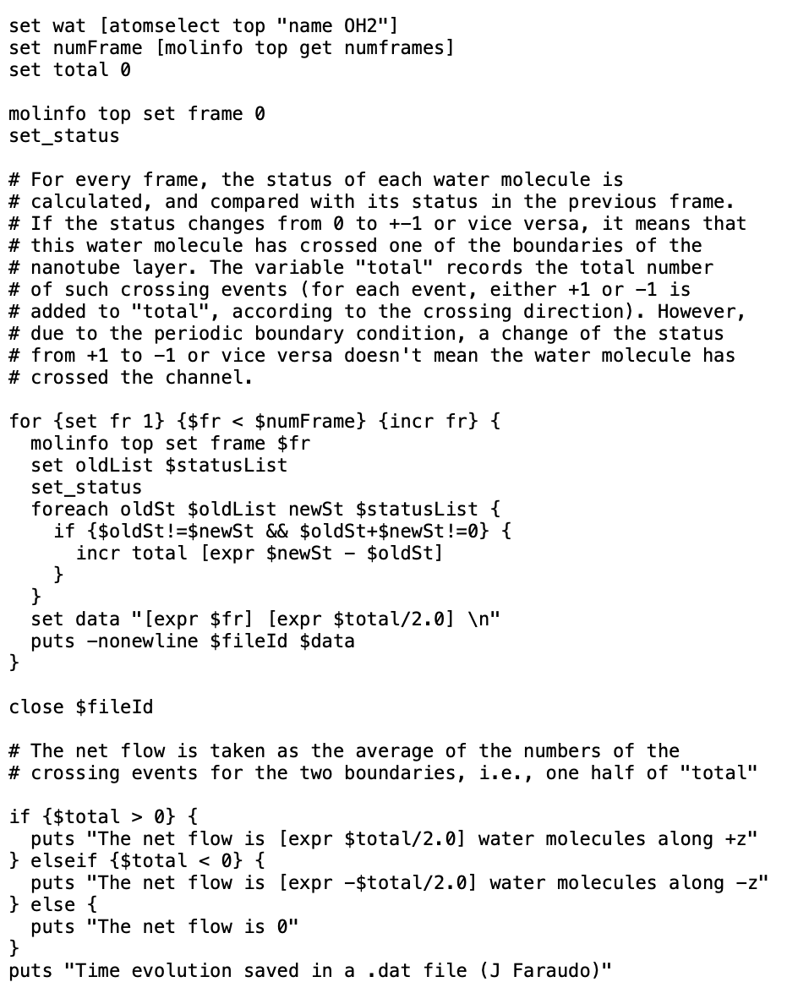
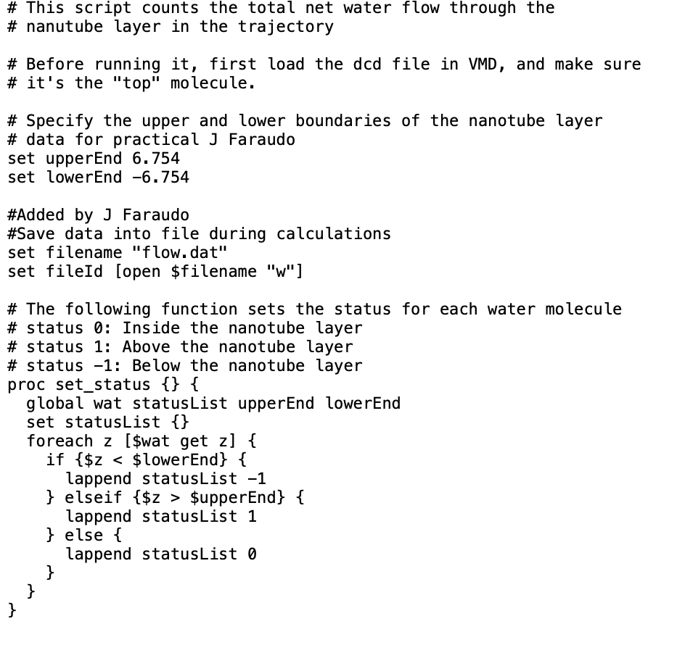
ANALYSIS
flow.tcl
Notes:
To analyze the data, I used Jordi's version of the flow.tcl and permeation.tcl scripts.
The flow.tcl script quantifies the water flow through the nanotubes. To do this, it defines that water molecules can have three different states: 0 when they are inside the nanotube, 1 when they are in the water reservoir with positive z, and -1 when they are in the reservoir with negative z. It iterates through the states of the molecules as the simulation progresses, and each time there is a change in state, it stores it. This way, knowing the value of all the changes, it is possible to determine the net flux and in which direction it goes. However, the issue with this script is that since the simulations are conducted under periodic boundary conditions, molecules can pass from one reservoir to another without passing through the nanotube. Therefore, the flux is calculated as the number of state changes divided by 2 (the number of periodic boundaries in z).

Slide 19
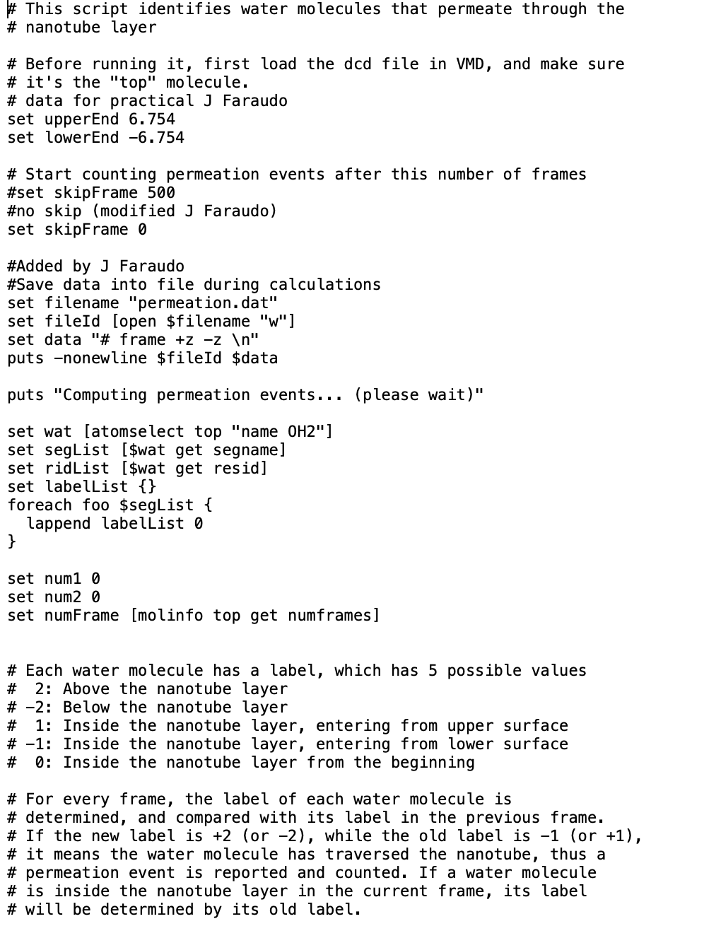
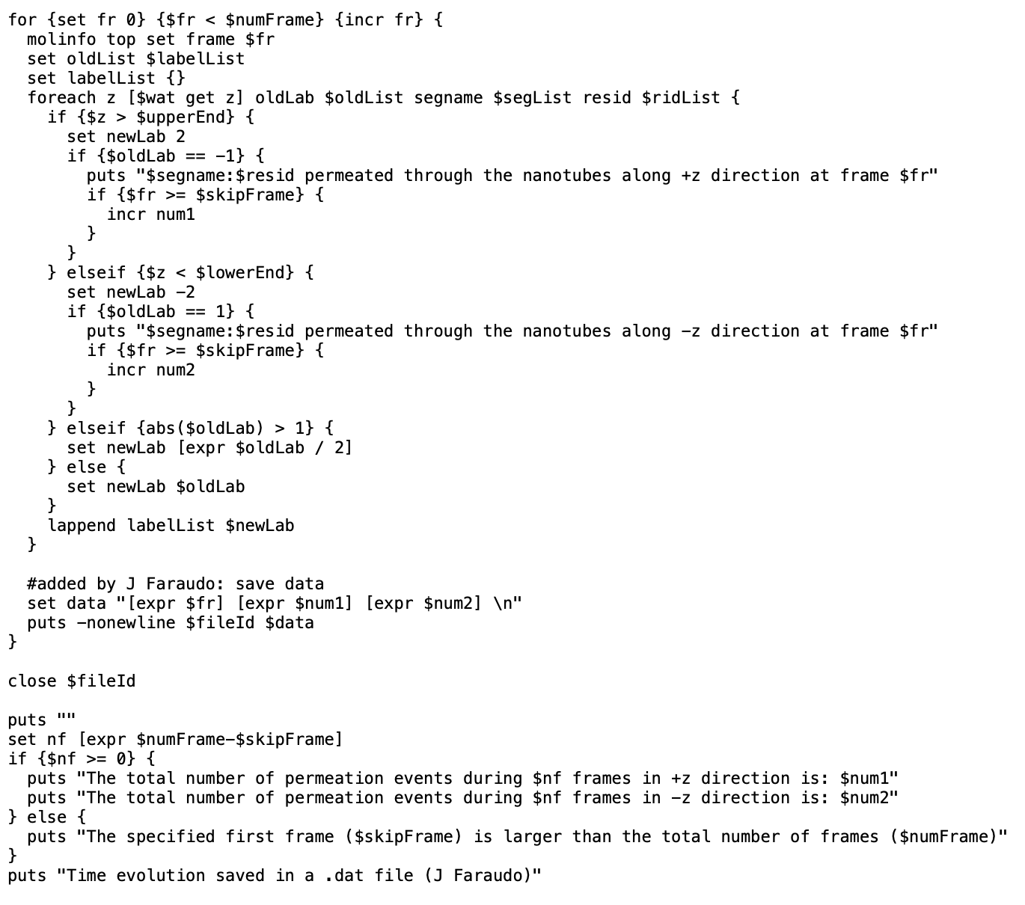
ANALYSIS
permeation.tcl
Notes:
The permeation.tcl script is a version that gives us the number of permeations into the nanotube. Understanding permeation as the crossing from a reservoir into the interior of the nanotube. To do this, water molecules can have 5 different states: -2 if they are in the reservoir with negative z, 2 if they are in the reservoir with positive z, 0 if they were in the nanotube at the beginning, -1 if they are in the nanotube but previously were in the reservoir with negative z, and +1 if they are in the nanotube but came from the reservoir with positive z. This way, if we have a record of the previous state of each molecule and the record changes by one unit, it means it has crossed from a reservoir into the interior of the nanotube. By knowing if this change is positive or negative, we can determine from where to where it has crossed.

Slide 20
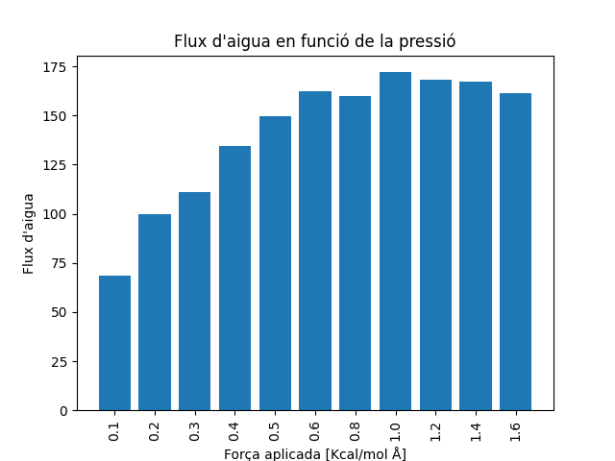
RESULTS
Notes:
Here are the results obtained with the flow.tcl script. As we can see, roughly from 0.6 of applied force onwards, the total flux stabilizes.

Slide 21
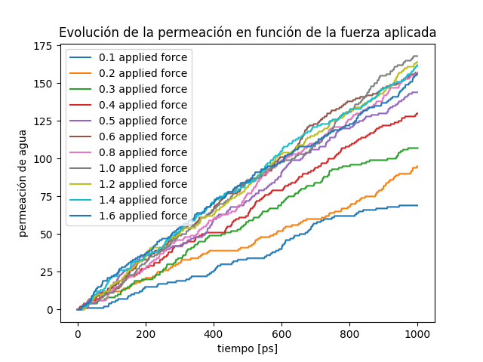
RESULTS
Notes:
In this graph, we can see the evolution of permeation over time for all forces. It's not very clear, but if you look closely at the graph, you can see how permeation evolves more rapidly as time passes in the simulation until approximately this purple line that we can see around (0.5), beyond which the lines start to intersect each other, even alternating their order again. From around 0.6, transport saturates.

Slide 22
CONCLUSIONS
Saturation at 10,4 GPa
Maximum velocity of 8,15·10¹⁰ molec/seg
12,5 litres/min with a faucet full of CNTs
Notes:
I must say that at the beginning, upon seeing these results after having conducted all the simulations, I was somewhat disappointed because I thought I had configured something incorrectly or the like. However, what we are seeing with these data is a very interesting phenomenon. What we are witnessing is how we have reached the maximum speed at which two nanotubes can transport water molecules. This is because, when conducting simulations with the same maximum amount of time, no matter how much pressure we apply, no more water molecules will pass through.
If we average the number of water molecules from force 0.6 to 1.6, which is the maximum I reached, we find that in 1 ns, 163 molecules have been transported. This gives us a velocity of 8.15*10^10 molecules/second. Standard faucets have a diameter of roughly 15mm and a flow rate of 10 liters/minute. If we fill this diameter with nanotubes as simulated, we could fit 8.57*10^13 nanotubes, which would give us a flow rate of 12.5 liters/minute.

